Slide 1
Action Recognition
Team - Geek Squad
Team members:
Ruchitha
Suresh
Vinay
Harsha

Slide 2
What is Action Recognition?
Human action recognition has become an active research area in recent years, as it plays a significant role in video understanding. In general, human action can be recognized from multiple modalities, such as appearance, depth, optical flows, and body skeletons.
In the video domain, it is an open question whether training an action classification network on a sufficiently large dataset, will give a similar boost in performance when applied to a different temporal task or dataset. The challenges of building video datasets has meant that most popular benchmarks for action recognition are small, having on the order of 10k videos.

Slide 3
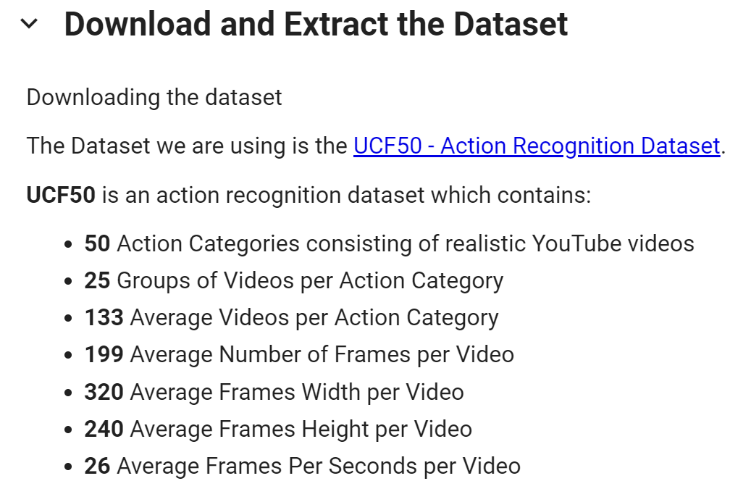
Datasets USED for Training
UCF101 - Action Recognition Data Set - https://www.crcv.ucf.edu/data/UCF101.php

Slide 4
Methods Used for Classification
Classification using CNN
Classification using CNN-RNN
Classification using Transformers

Slide 5
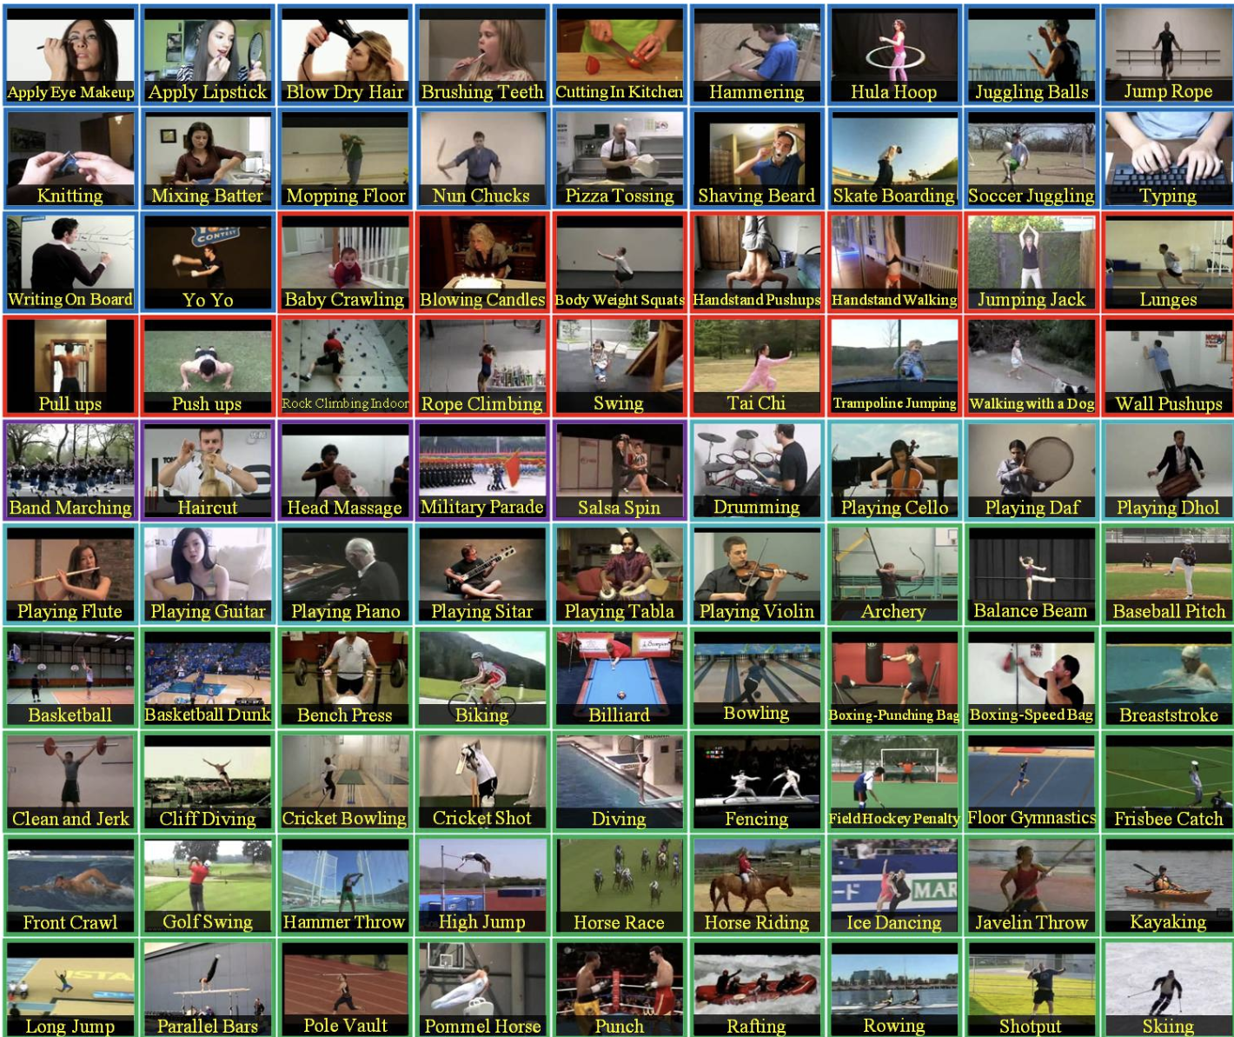
Visualize the Data with its Labels:

Slide 6

Read & Preprocess the Dataset
image_height and image_weight
max_images_per_class:
dataset_directory:
Split the Data into Train and Test Set

Slide 7
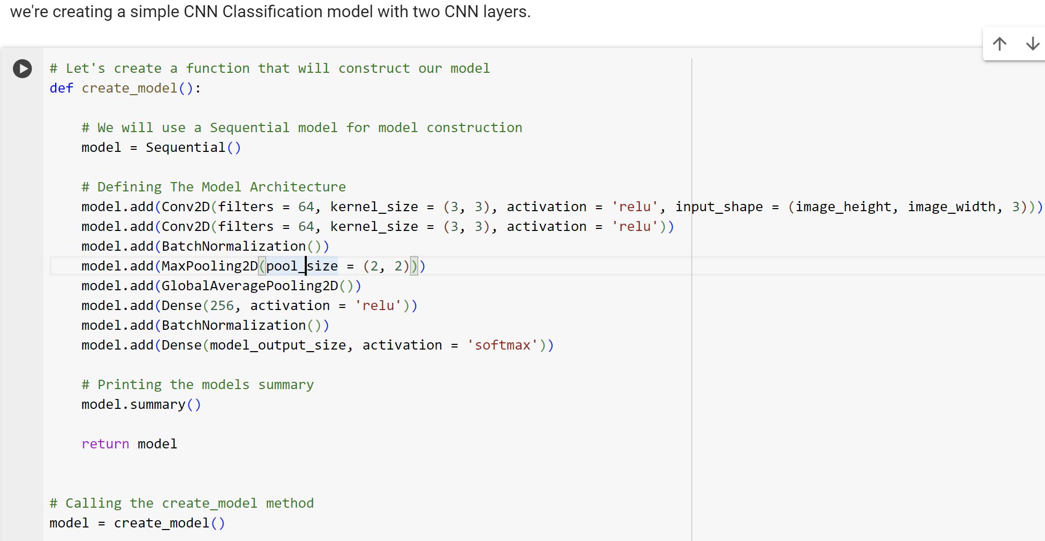
Construct the Model

Slide 8
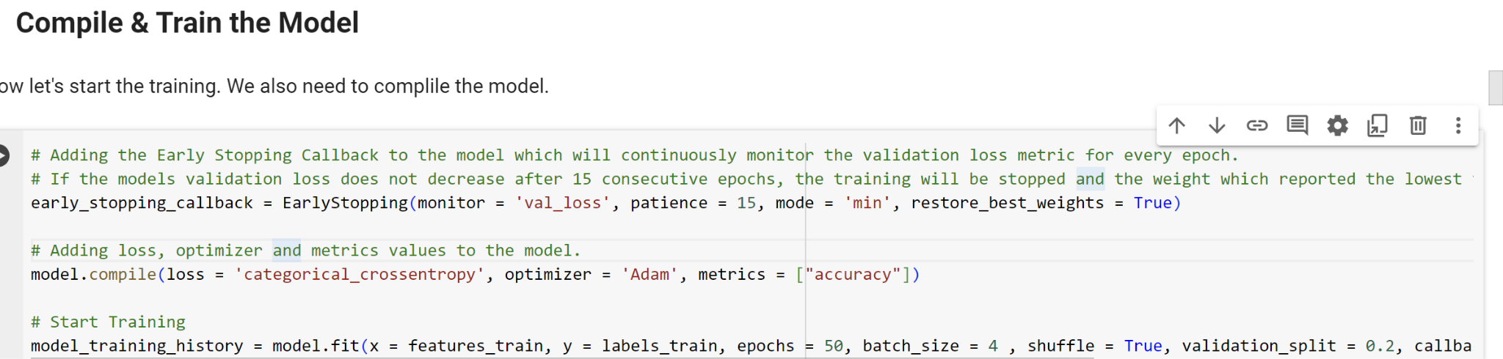
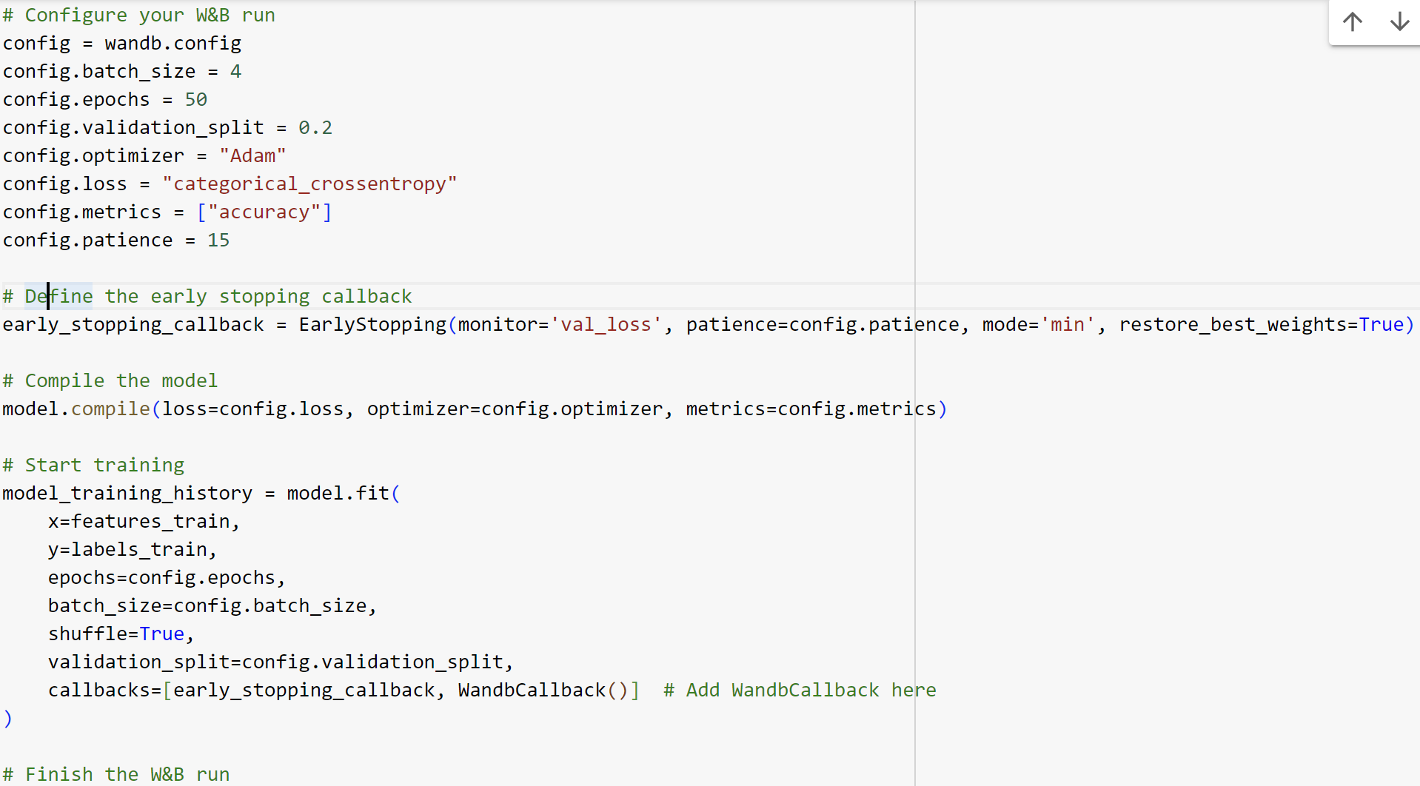

Slide 9
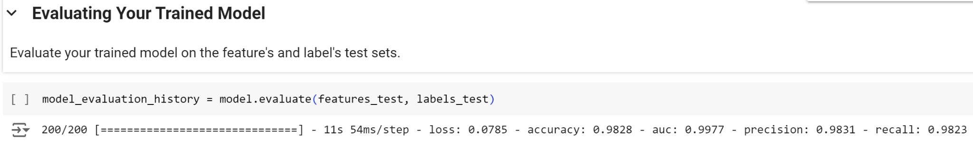

Slide 10
Weights and Biases
Weights & Biases (W&B) for monitoring the training process of a Convolutional Neural Network (CNN) for video classification.
Batch Size and Epochs: The model processes 4 samples per batch and trains for a maximum of 50 epochs.
Validation and Optimization: Utilizes 20% of the data for validation and employs the Adam optimizer with a categorical cross entropy loss function, ideal for multi-class classification.
Performance Metrics: Model performance is evaluated based on accuracy.
Early Stopping Callback: Prevents overfitting by stopping training when validation loss does not improve, ensuring optimal model weights are used.
Model Compilation and Weights & Biases Integration: Training involves shuffling, validation splits, and uses callbacks for both early stopping and logging metrics to the Weights & Biases platform for real-time monitoring.

Slide 11
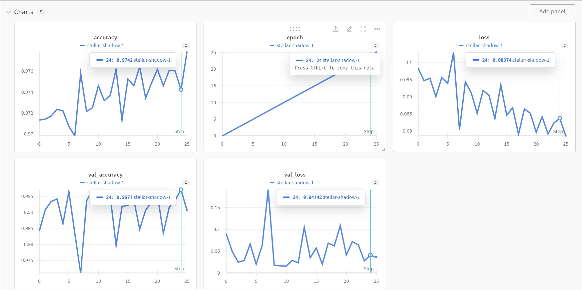

Slide 12
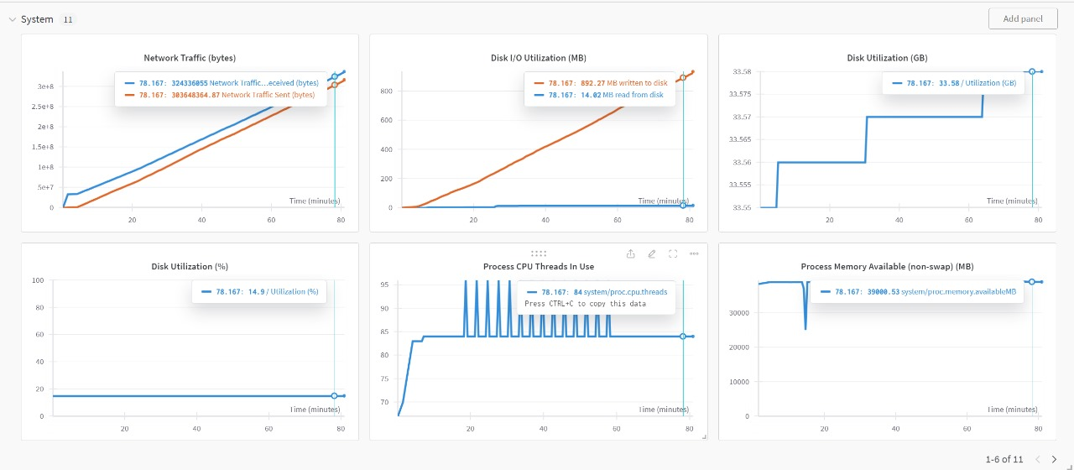

Slide 13
Tracking Using MLFLOW

Slide 14
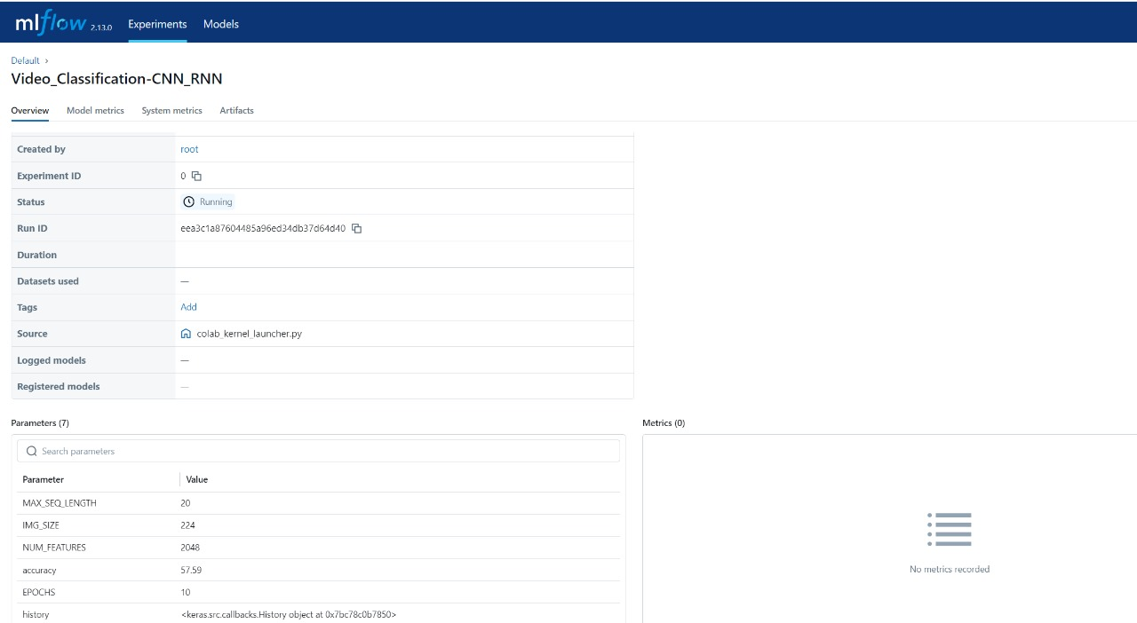
MLFLOW Tracking
The MLflow Tracking API lets you log metrics and artifacts (files from your data science code) in order to track the history of your runs.

Slide 15
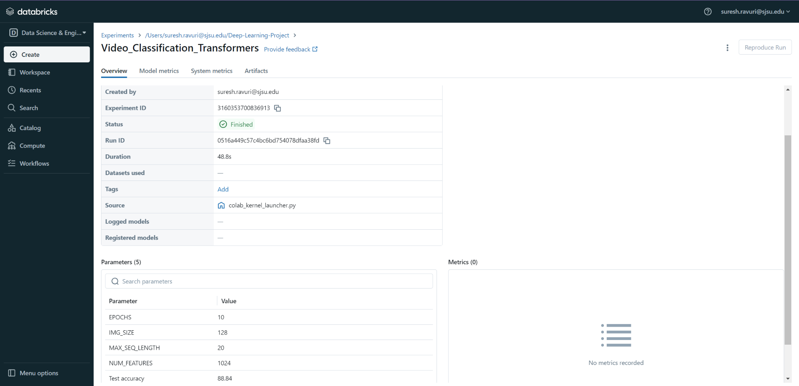
MLOPS Using Databricks

Slide 16
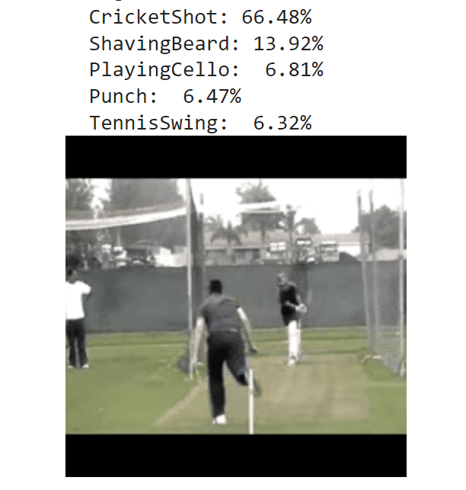
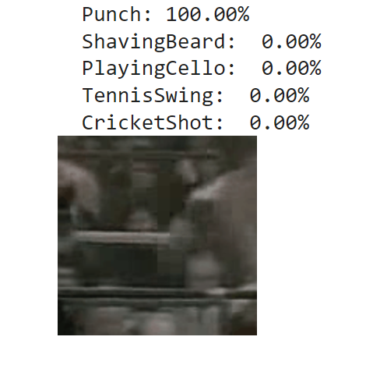

Slide 17
Model Training Results
CNN Model:
Training Accuracy: 97.55%
Validation Accuracy: 98.95%
Test Metrics: Accuracy: 80.02%, AUC: 93.70%, Precision: 89.93%, Recall: 79.95%
Strengths: High precision and overall accuracy.
Weaknesses: Lower recall compared to other metrics.
CNN-RNN Model:
Accuracy: 57.59%
Strengths: Suitable for sequence data.
Weaknesses: Lower accuracy, indicating possible inefficiencies.
Transformers Model:
Accuracy: 88.84%
Strengths: Handles complex temporal dynamics effectively.
Weaknesses: Lower accuracy than CNN when evaluated on test data.
Conclusion: The CNN model outperforms the others in precision and validation accuracy, making it the best choice for scenarios requiring high accuracy and precision. Transformers offer advantages for complex temporal patterns but do not reach the CNN's raw performance levels.

Slide 18
THANKS!

